Slide 1
Fortgeschrittene Spieleentwicklung (Shader Programming)

Slide 2
Goal of the lecture
For you to understand concepts
Programable hardware pipeline
Scene showcasing real-time effects
Demo
Game
Show examples

Slide 3
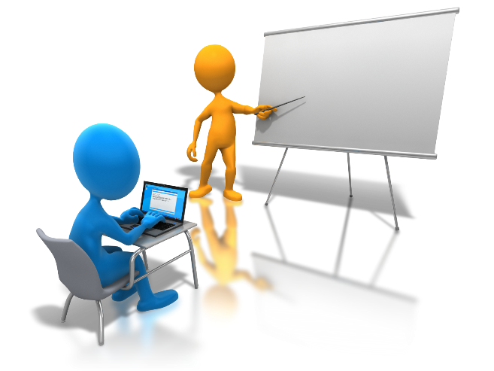

Todo
Work on examples given in lecture
Create a project (interactive demo)
<1 minute video (YouTube)

Slide 4
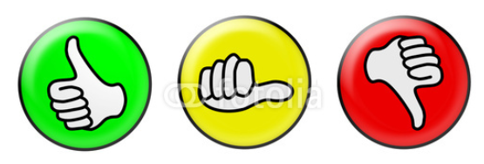
Grading
Project outcome
Active participation in lecture

Slide 5
What do you know?
Linear algebra
CG basics and OpenGL (cg lecture)
Pipeline
Transforms
Rasterization
Texturing

Slide 6
Lecture Content
Topics
Programmable hardware Pipeline
Game Physics
particle systems
...
Cameras
Advanced Lighting
Advanced Texturing (Sampling Theory)
Levels of Detail
Real-Time Shadows (shadow mapping)
Coherence Methods

Slide 7
Programing framework
github.com/danielscherzer/Framework
C#
Mix of Java and C++
MS Visual Studio
Linux/MacOS guys can use mono, but have to convert final version (a.k.a. upload version)
Graphics: OpenGL graphics API (many details later)
OpenTK
C# wrapper for OpenGL

Slide 8
Moodle
Deliverable/project upload
Forums for questions
Link to github
Slides
Examples
Framework

Slide 9
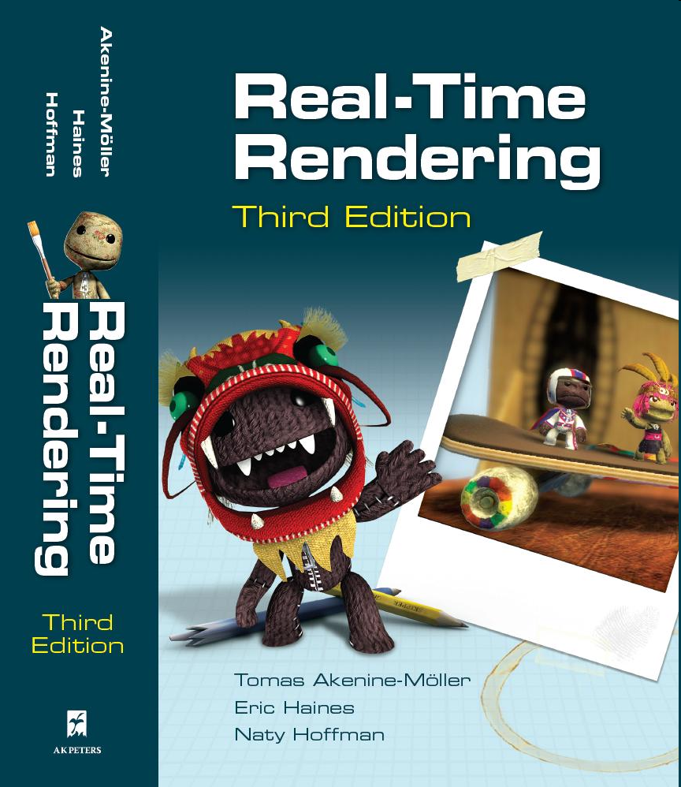
Books
Real-Time Rendering, Third Edition
Tomas Akenine Möller, Eric Haines
AK Peters, 2008 (3rd edition)
Covers all standard methods
www.realtimerendering.com
Real-Time Rendering Resources
Huge collection of on/off-line resources
Online books (#books)
Software
API information

Slide 10
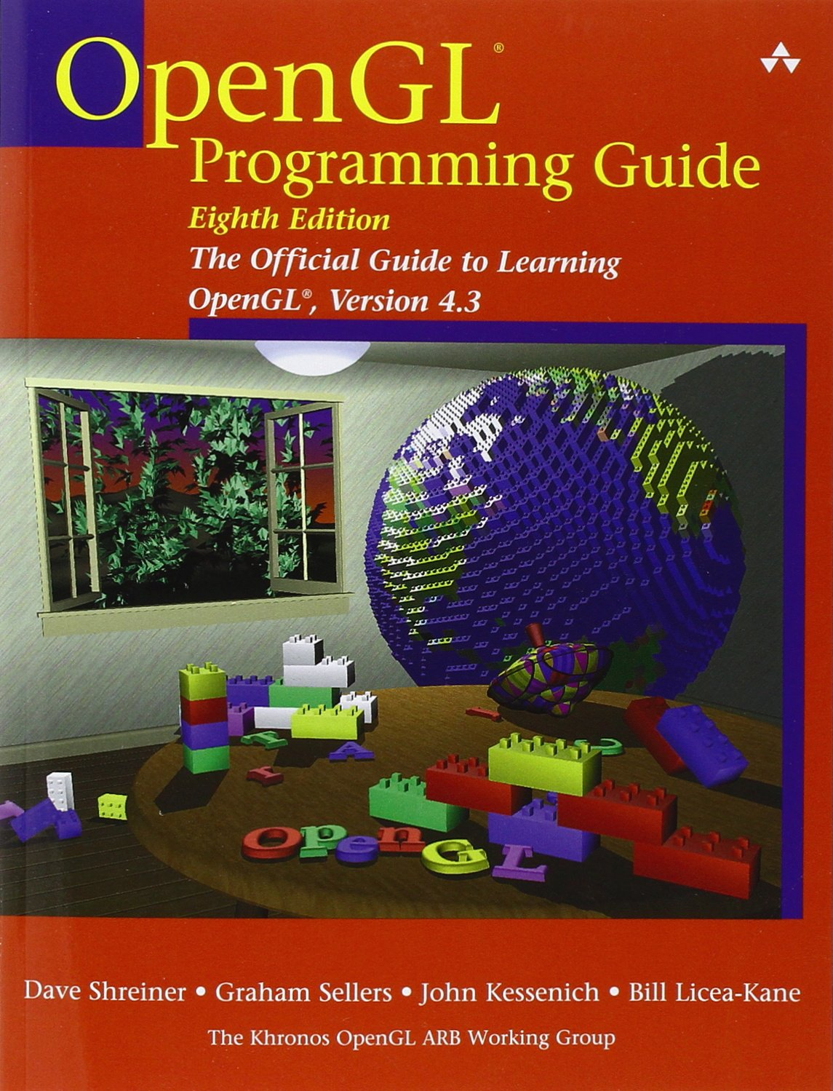
Books on OpenGL
Basic knowledge about OpenGL
“Red Book”
Free: Google: “redbook pdf”
Also describes GLSL shader programming language
Latest: 8th Edition
Tutorials
nehe.gamedev.net

